Slide 1
Personal and Consumer Health
Hands-Only CPR
By: Luanne Warren

Slide 2
Essential Standard
8.PCH.4 – Analyze necessary steps to prevent and respond to unintentional injury.
Clarifying Objective
8.PCH.4.2 – Demonstrate basic CPR techniques and procedures on a mannequin and pass a Red Cross or American Heart Association approved test of CPR skills.

Slide 3
Objectives
The student will:
demonstrate proper procedures of check, call, care
demonstrate basic CPR techniques on a mannequin
pass a Red Cross or American Heart Association approved test of CPR skills

Slide 4
Objectives
I can pass a Red Cross or American Heart Association approved test of CPR skills.
I will demonstrate proper procedures of check, call, and care.
I will demonstrate basic CPR techniques on a mannequin.

Slide 5
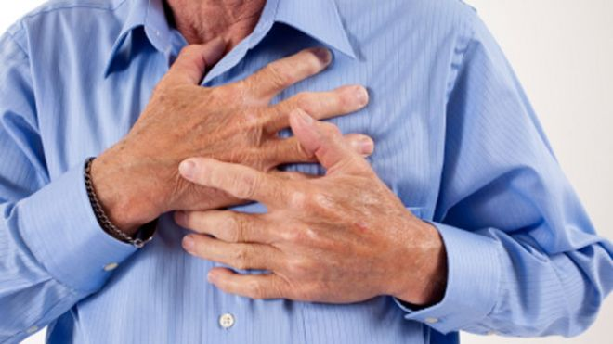
Sudden cardiac arrest is the leading cause of death in adults.

Slide 6
CPR
It is estimated that about 60 percent of heart attacks resulting in cardiac arrest occur in the presence of a witness who might be able to save the victim.

Slide 7
CPR
About two-thirds of the deaths caused by cardiac arrest occur before victims can reach a hospital.
CPR doubles a person’s chance of survival from sudden cardiac arrest.

Slide 8
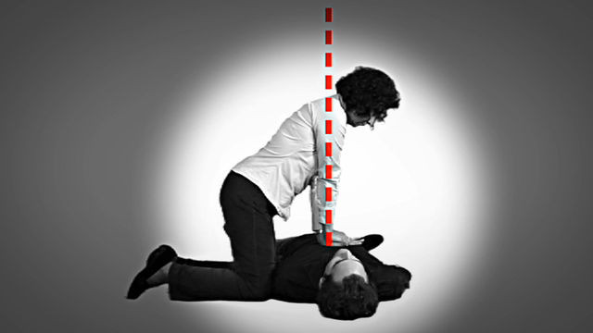
CPR provides oxygenated blood to the brain and heart and keeps these organs alive until defibrillation shocks the heart back to a normal rhythm.

Slide 9
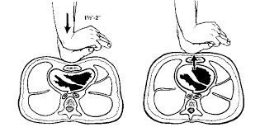

Slide 10
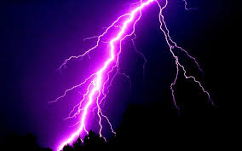
Recognize the signs and symptoms of cardiac events/sudden death emergencies (heart attack, drowning, electrocution, and asphyxiation).

Slide 11
The Three C’s of Emergencies!

Slide 12
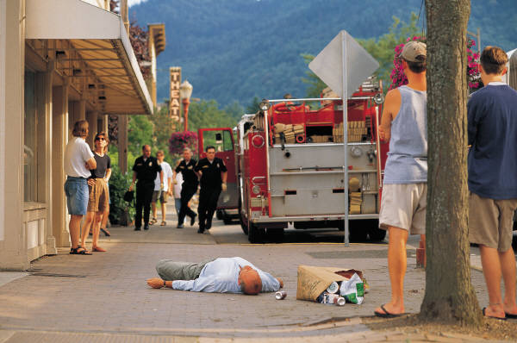
1. Check out the situation.
Secure the scene.

Slide 13
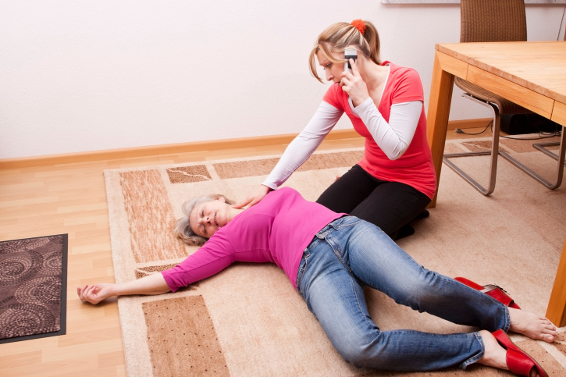
2. Call for help.
locate nearest phone.
provide EMS with current address.
provide number for EMS to contact

Slide 14
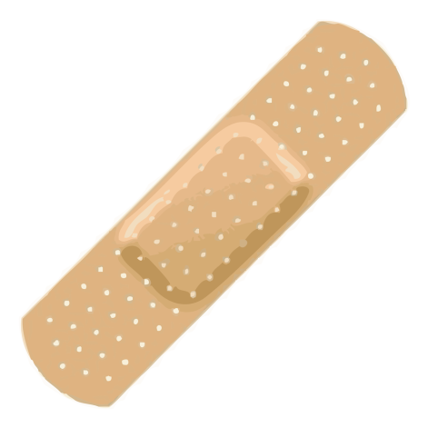
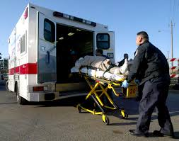
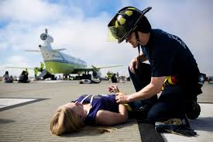
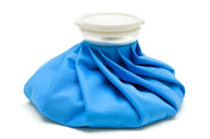
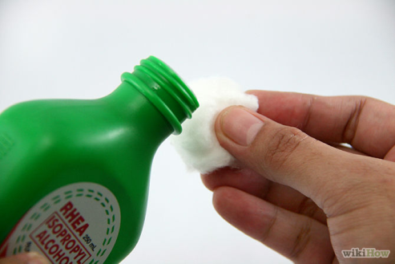
3. Care for the victim.

Slide 15
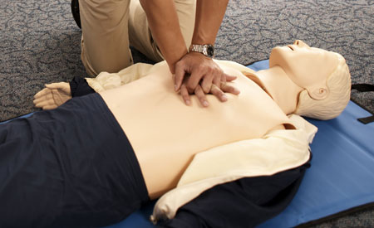
CPR and AED Use for Schools- Part 1- Hands Only CPR
Click to start video

Slide 16
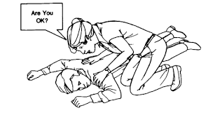
Step 1
Check the scene for safety.
Tap and shout to check responsiveness of the victim.
Are you okay?

Slide 17
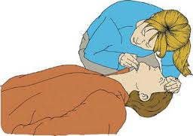
Step 2
Check breathing
Open the airway
Tilt the head back by pressing on the forehead with one hand and lifting the chin with the other.
LOOK, LISTEN, and FEEL for breathing

Slide 18
If the victim is unresponsive and there is no sign of breathing, immediately send someone or call for help (911), and then begin CPR.

Slide 19
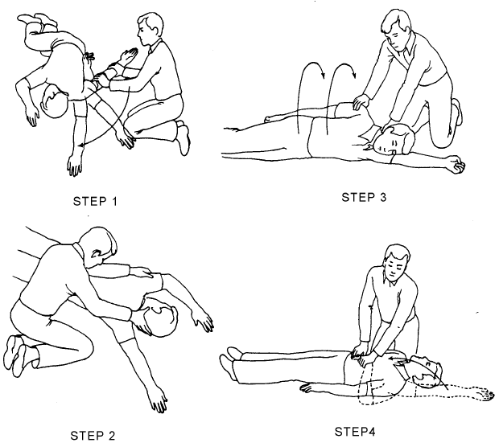
Position victim for compressions.

Slide 20
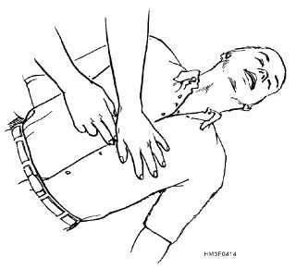
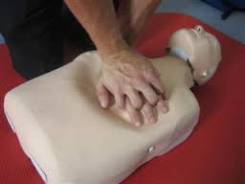
Place the heel of one hand on the center of the breastbone, between the nipples.
Place your free hand on top and lock fingers.

Slide 21
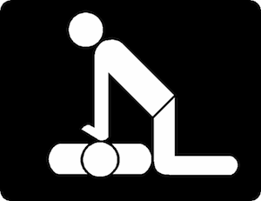
Compress the chest with your upper body weight keeping the heel of your hand centered on the breastbone.
Keep elbows locked.

Slide 22
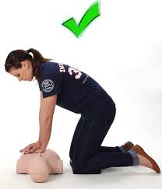
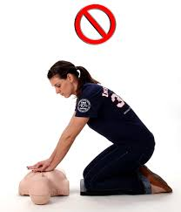
Correct body position.

Slide 23
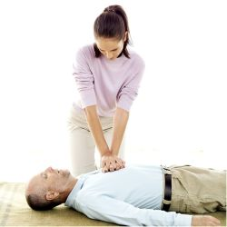
Step 3
Give chest compressions at a rate of 100 per minute. compression depth (2 inches)
Speed (100 per minute)

Slide 24
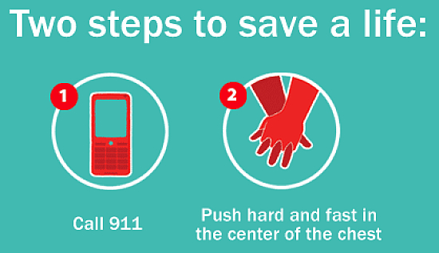
Continue compressions until…
the victim shows an obvious sign of life
the scene becomes unsafe
an AED becomes available
you are too exhausted to continue
or a trained responder takes over

Slide 25
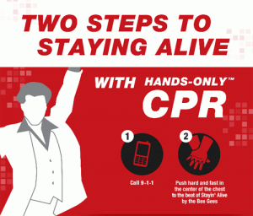
Practice hands-only CPR
Click to start music if it does not start automatically

Slide 26
Hands-Only CPR
Quiz

Slide 27
Question 1
What is the correct order for the three”C’s”?
A. call, check care
B. check, call, care
C. care, call, check
D. care check call

Slide 28
Your answer is
CORRECT!

Slide 29
Wrong Answer

Slide 30
Question 2
The leading cause of death in adults is ____________.
A. Suicide
B. Cardiac Arrest
C. High Blood Pressure
D. Choking

Slide 31
Your answer is
CORRECT!

Slide 32
Wrong Answer

Slide 33
Question 3
The preferred way to check for breathing is:
A. look, listen, and feel
B. fingers on the carotid artery
C. shake, rattle, and roll
D. tap and shout

Slide 34
Your answer is
CORRECT!

Slide 35
Wrong Answer

Slide 36
Question 4
You should continue CPR until:
A. The victim begins breathing on his/her own
B. Emergency Medical Technicians arrive
C. You get relief from another person trained in CPR
D. Any of the above

Slide 37
Your answer is
CORRECT!

Slide 38
Wrong Answer

Slide 39
Question 5
For compressions in adult CPR hands should be placed on:
A. The center of the breast bone
B. On the left side of the chest directly on top of the heart
C. The center of either lung
D. All of the above are acceptable

Slide 40
Your answer is
CORRECT!

Slide 41
Wrong Answer

Slide 42
Question 6
What is the preferred method for determining responsiveness?
A. Scream and Shake
B. Feel the forehead
C. Tap and Shout
D. Check the wrist

Slide 43
Your answer is
CORRECT!

Slide 44
Wrong Answer

Slide 45
Question 7
Who will you call in a cardiac emergency?
A. The victim's relative
B. A local news station
C. Your local Red Cross
D. 911

Slide 46
Your answer is
CORRECT!

Slide 47
Wrong Answer

Slide 48
Question 8
What rate should compressions be given?
A. 75 beats per minute
B. 90 beats per minute
C. 100 beats per minute
D. 125 beats per minute

Slide 49
Your answer is
CORRECT!

Slide 50
Wrong Answer

Slide 51
Question 9
How deep should the chest be compressed during CPR.
A. 1 inch
B. 1½ inches
C. 2 inches
D. 2½ inches

Slide 52
Your answer is
CORRECT!

Slide 53
Wrong Answer

Slide 54
Question 10
When calling 911/EMS what information should be provided?
A. Condition of the victim
B. Condition of the victim and current address
C. Current address and number to call back
D. All of the above

Slide 55
Your answer is
CORRECT!

Slide 56
Wrong Answer

Slide 57
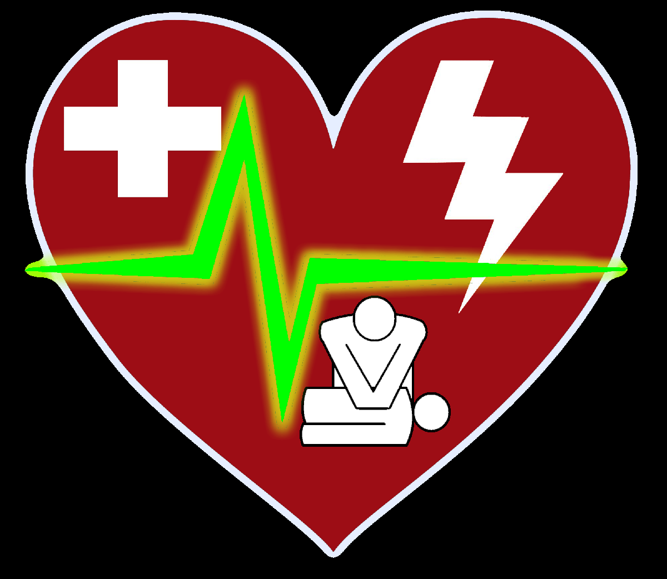
Now time it is time to perform Hands-Only CPR!

